Slide 1
Regresión Por Mínimos Cuadrados Parte III
Dr. Luis Sanchez

Slide 2
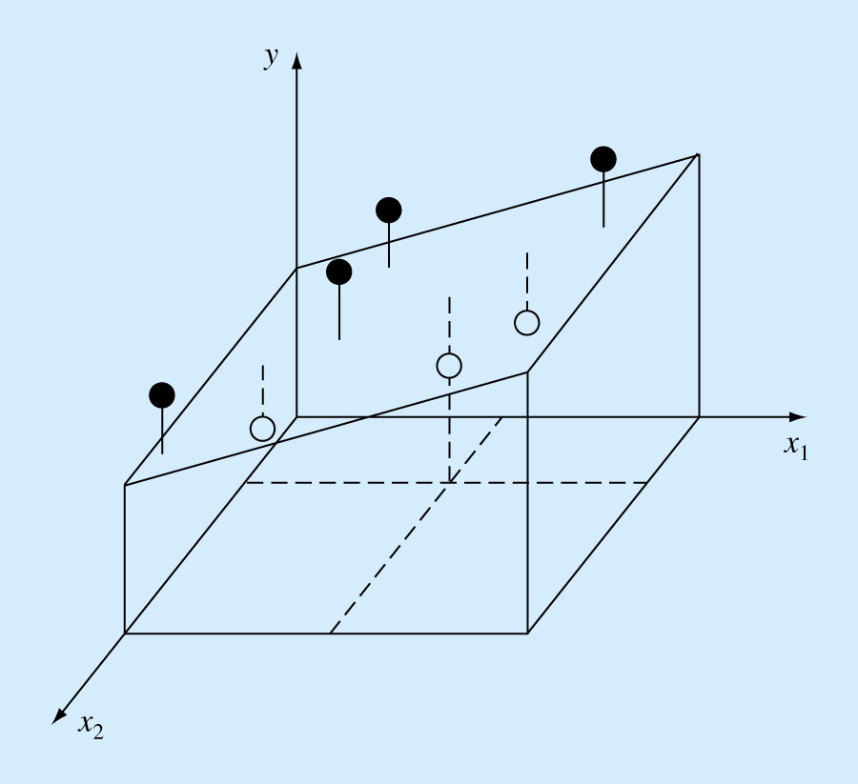
Multiple Linear Regression
A useful extension of linear regression is the case where y is a linear function of two or more independent variables. For example:
y = a_{o} + a₁x₁ + a₂x₂
For this 2-dimensional case, the regression line becomes a plane as shown in the figure below.

Slide 3
Multiple Linear Regression
Which method would you use to solve this Linear System of Equations?

Slide 4
Multiple Linear Regression
Once again, solve by any matrix method
Cholesky decomposition is appropriate - symmetric and positive definite
Very useful for fitting power equation

Slide 5
Example: Strength of concrete depends on cure time and cement/water ratio (or water content W/C)

Slide 6
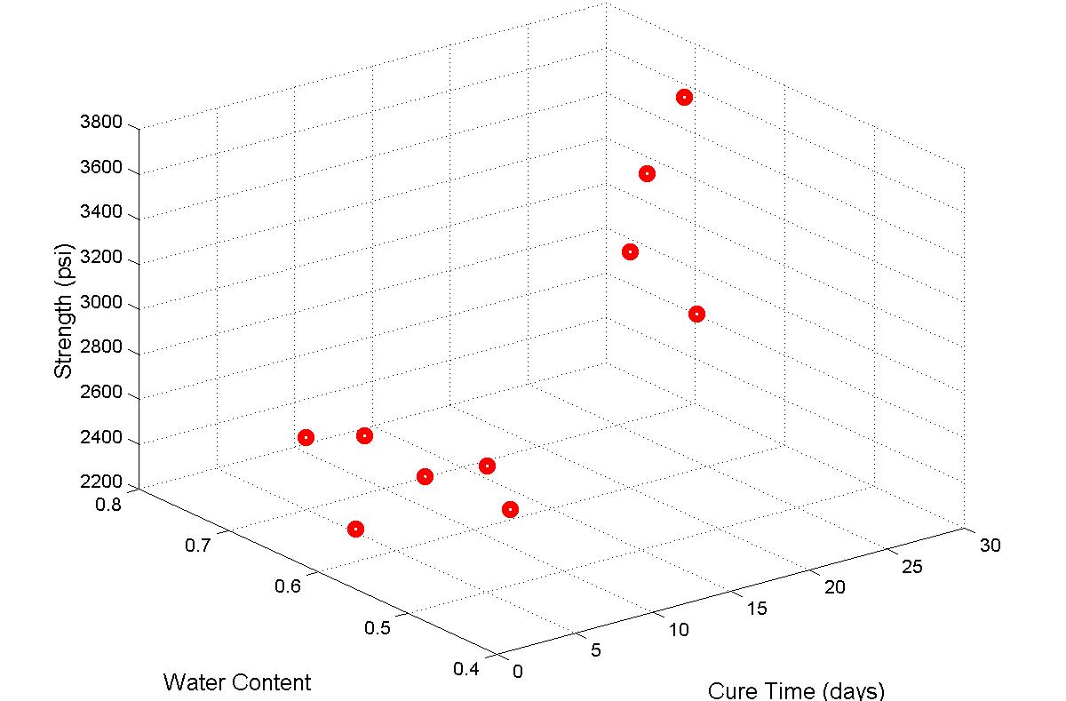
» x1=[2 4 5 16 3 7 8 27 14 20];
» x2=[0.42 0.55 0.7 0.53 0.61 0.67 0.55 0.66 0.42 0.58];
» y=[2770 2639 2519 3450 2315 2545 2613 3694 3414 3634];
» H=plot3(x1,x2,y,'ro'); grid on; set(H,'LineWidth',5);
» H1=xlabel('Cure Time (days)'); set(H1,'FontSize',12)
» H2=ylabel('Water Content'); set(H2,'FontSize',12)
» H3=zlabel('Strength (psi)'); set(H3,'FontSize',12)

Slide 7
Hand Calculations

Slide 8
Solve by Cholesky decomposition
Forward and Back Substitutions

Slide 9
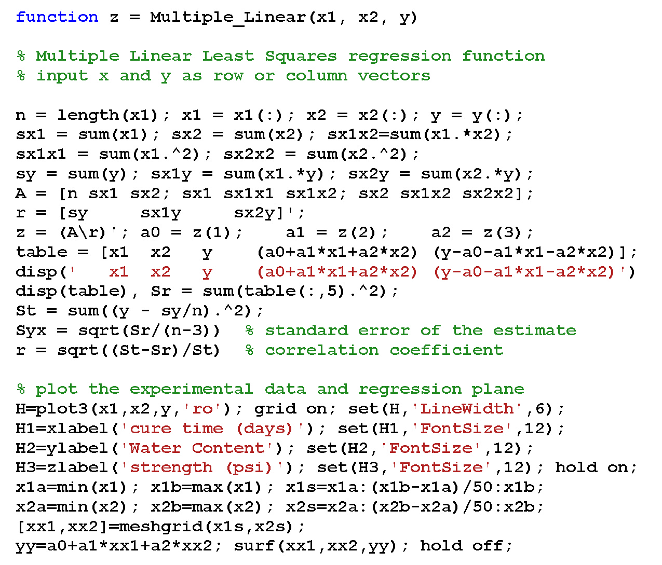

Slide 10
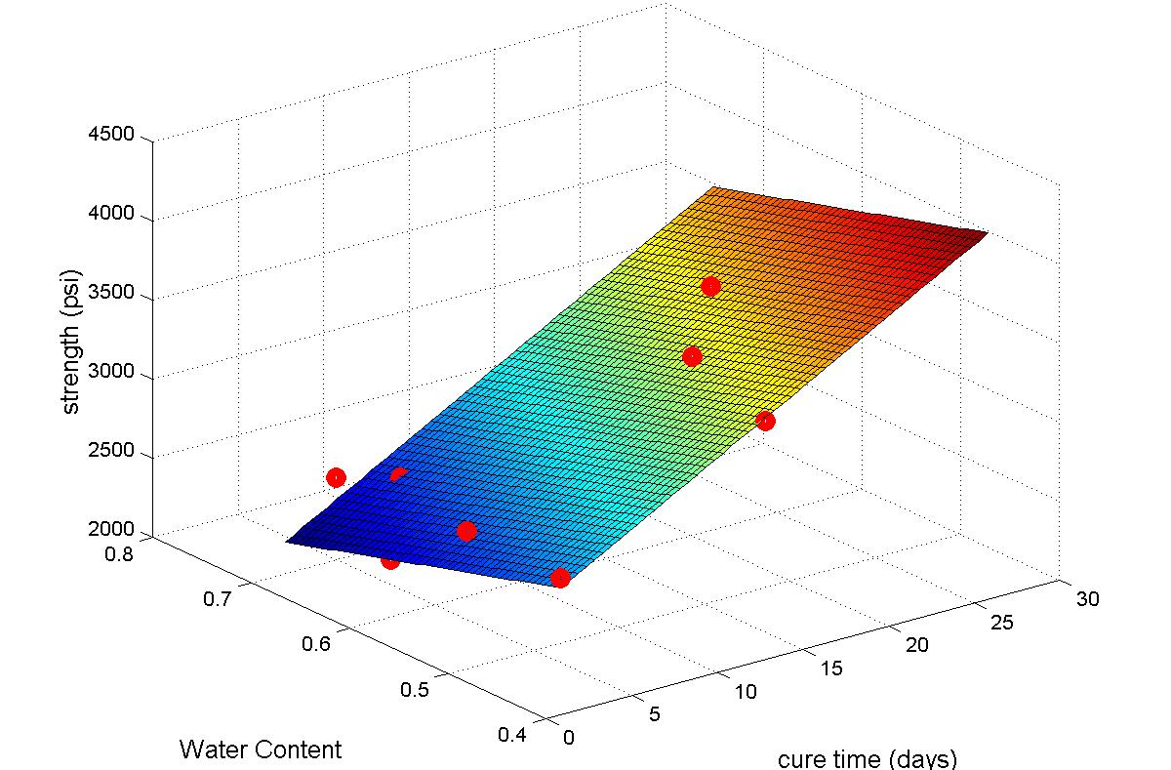
Multiple Linear Regression

Slide 11
General Linear Least Squares
Simple linear, polynomial, and multiple linear regressions are special cases of the general linear least squares model
Examples:
Linear in a_{i} , but z_{i} may be highly nonlinear

Slide 12
General Linear Least Squares
General equation in matrix form
Where
Dependent variables
Regression coefficients
Residuals

Slide 13
General Linear Least Squares
As usual, take partial derivatives to minimize the square errors S_{r}
This leads to the normal equations
Solve this for {A} using Cholesky LU decomposition, or matrix inverse

Slide 14
MATLAB Example
Given x and y data in columns, solve for the coefficients of the best fit line for y=a₀+a₁x+a₂x² Z = [ones(size(x) x x.^2] a = (Z’*Z)\(Z’*y)
Note also that MATLAB’s left-divide will automatically include the [Z]^{T} terms if the matrix is not square, so a = Z\y would work as well
To calculate measures of fit: St = sum((y-mean(y)).^2) Sr = sum((y-Z*a).^2) r2 = 1-Sr/St syx = sqrt(Sr/(length(x)-length(a)))

Slide 15

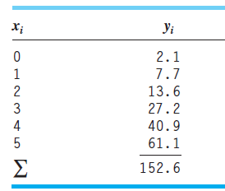
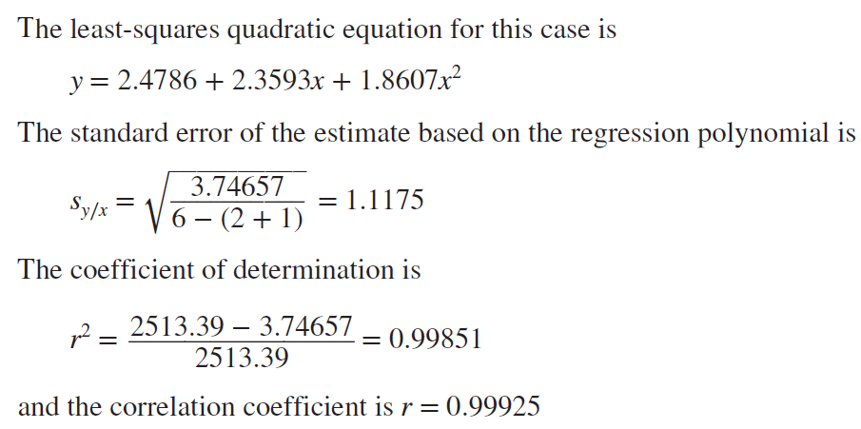
Fit a second-order polynomial to the data in the first two columns:

Slide 16
Example with MATLAB
>> x=[0 1 2 3 4 5]';
>> y=[2.1 7.7 13.6 27.2 40.9 61.1]';
>> Z=[ones(size(x)) x x.^2]
Z =
1 0 0
1 1 1
1 2 4
1 3 9
1 4 16
1 5 25
>> Z'*Z
ans =
6 15 55
15 55 225
55 225 979
>> a=(Z'*Z)\(Z'*y)
a =
2.4786
2.3593
1.8607

Slide 17
Nonlinear Regression
Cases in engineering where nonlinear models – models that have a nonlinear dependence on their parameters – must be fit to data
For example,
Like linear models in that we still minimize the sum of the squares of the residuals
Most convenient to do this with optimization

Slide 18
Nonlinear Regression
Use Taylor series expansion to linearize the original equation
Gauss-Newton method
Nonlinear function of a₁, a₂, …, a_{m}
Where f is a nonlinear function of x
(x_{i}, y_{i}) are one of a set of n observations

Slide 19
Nonlinear Regression
Use Taylor series for f, and truncate the higher-order terms
j = the initial guess
j+1 = the prediction (improved guess)

Slide 20
Nonlinear Regression
Plug the Taylor series into original equation
or

Slide 21
Where:

Slide 22
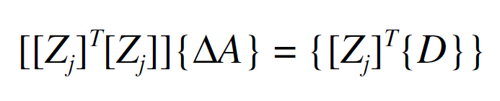
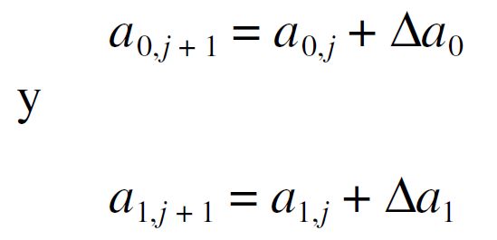
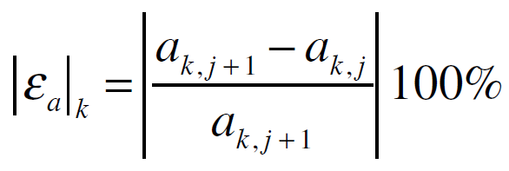
Si se aplica la teoría de los mínimos cuadrados lineales a la ecuación se obtienen las siguientes ecuaciones normales:
Así, el procedimiento consiste en resolver de la ecuación para {ΔA}, que se utiliza para calcular valores mejorados de los parámetros, como en:
Este procedimiento se repite hasta que la solución converge, es decir, hasta que:
Está por debajo de un criterio de terminación aceptable.

Slide 23
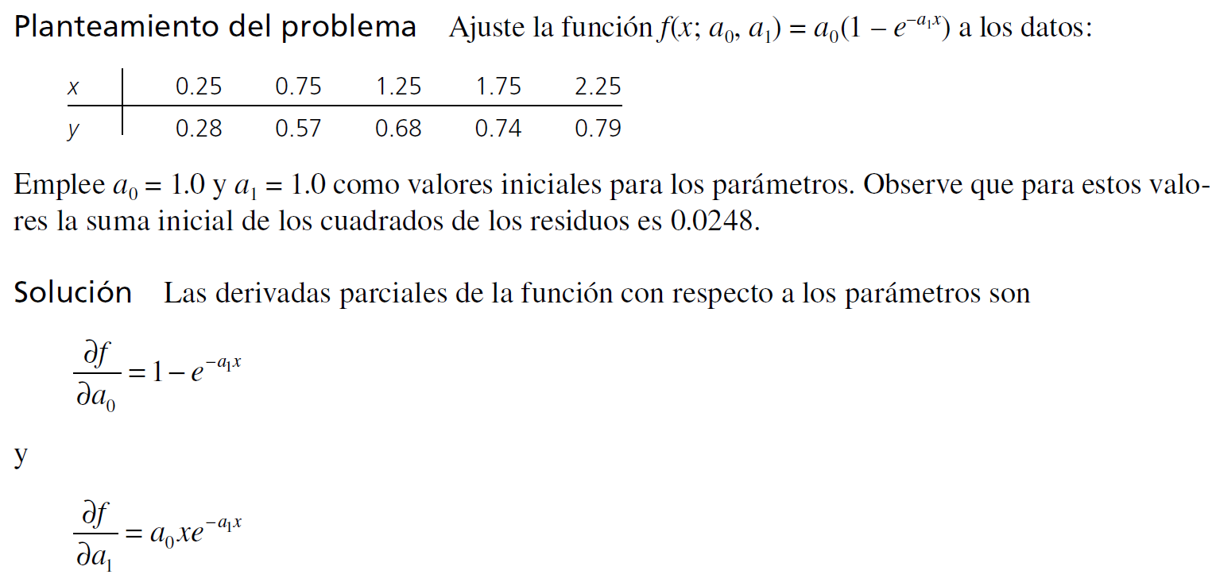
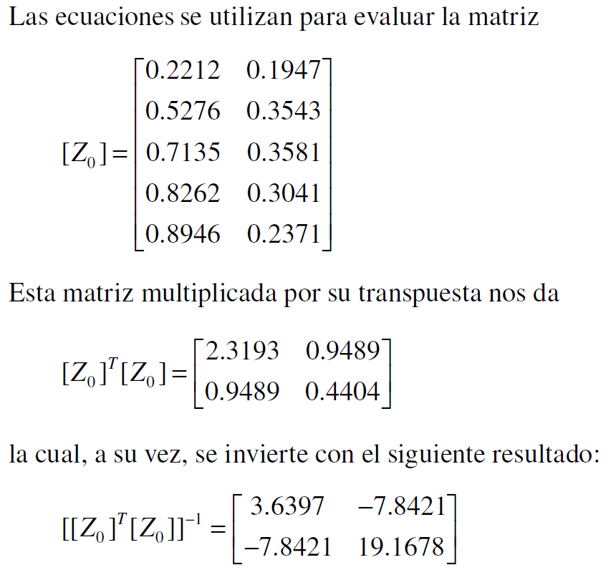
Ejemplo

Slide 24
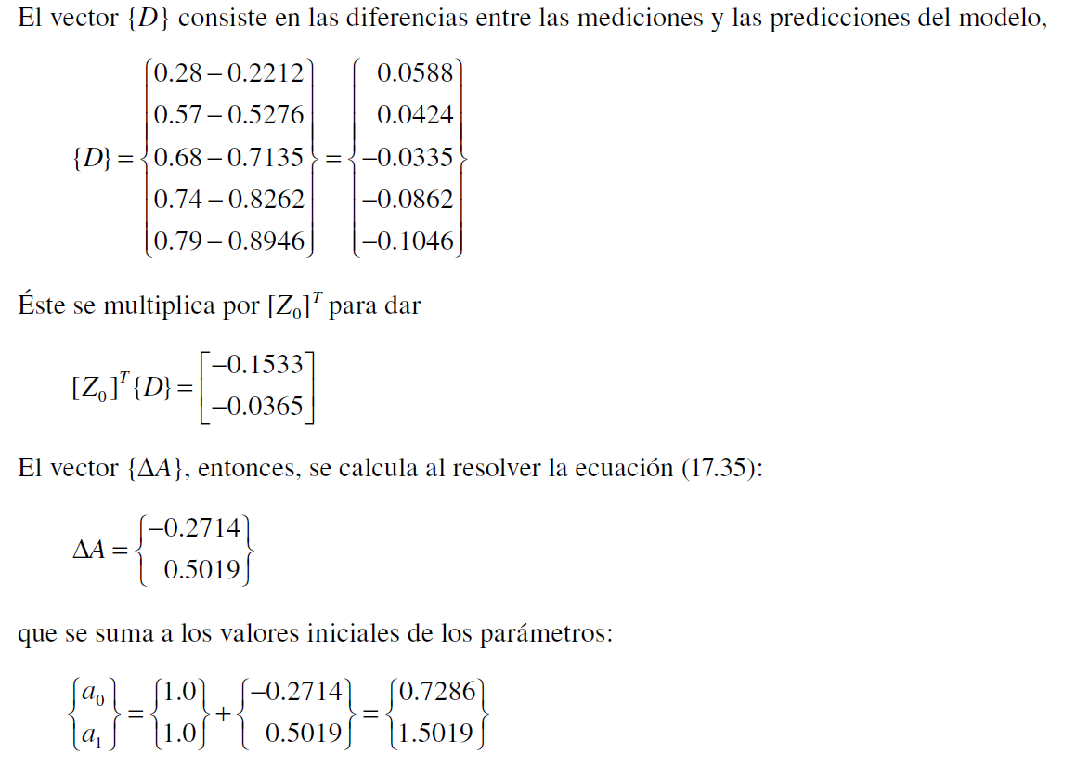
los estimados mejorados de los parámetros son a₀ = 0.7286 y a₁ = 1.5019.
Los nuevos parámetros dan una suma de los cuadrados de los residuos igual a 0.0242. La ecuación para el error se utiliza para obtener que e₀ y e₁ son iguales a 37 y 33%, respectivamente. El cálculo se repetiría hasta que esos valores estén abajo del criterio de terminación establecido. El resultado final es a₀ = 0.79186 y a₁ =1.6751. Tales coeficientes dan una suma de los cuadrados de los residuos de 0.000662.

Slide 25
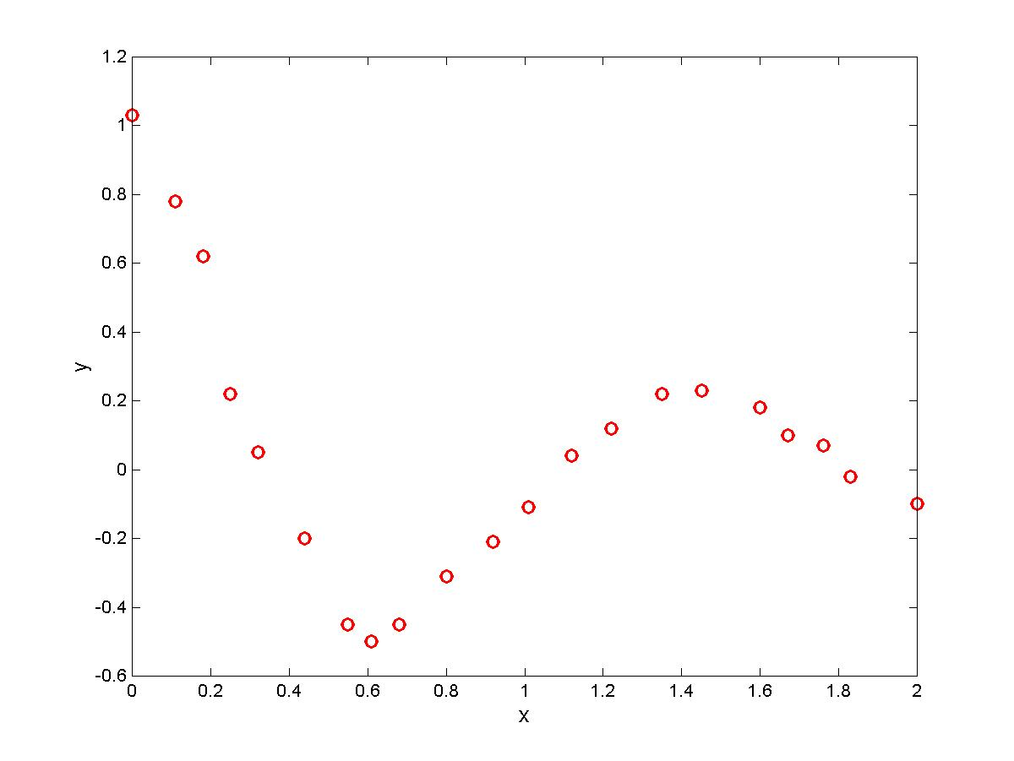
Example: Damped Sinusoidal
x = [0.00 0.11 0.18 0.25 0.32 0.44 0.55 0.61 0.68 0.80 ...
0.92 1.01 1.12 1.22 1.35 1.45 1.60 1.67 1.76 1.83 2.00];
y = [1.03 0.78 0.62 0.22 0.05 -0.20 -0.45 -0.50 -0.45 -0.31 ...
-0.21 -0.11 0.04 0.12 0.22 0.23 0.18 0.10 0.07 -0.02 -0.10];
Model it with

Slide 26
Gauss-Newton Method

Slide 27
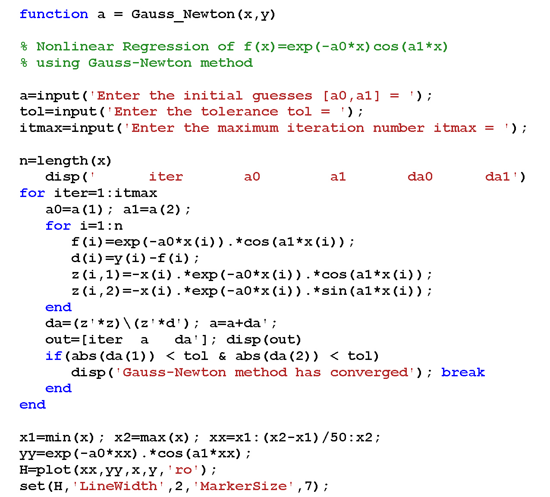

Slide 28
» [x,y]=mass_spring;
» a=gauss_newton(x,y)
Enter the initial guesses [a0,a1] = [2,3]
Enter the tolerance tol = 0.0001
Enter the maximum iteration number itmax = 50
n =
21
iter a0 a1 da0 da1
1.0000 2.1977 5.0646 0.1977 2.0646
2.0000 1.0264 3.9349 -1.1713 -1.1296
3.0000 1.1757 4.3656 0.1494 0.4307
4.0000 1.1009 4.4054 -0.0748 0.0398
5.0000 1.1035 4.3969 0.0026 -0.0085
6.0000 1.1030 4.3973 -0.0005 0.0003
7.0000 1.1030 4.3972 0.0000 0.0000
Gauss-Newton method has converged
a =
1.1030 4.3972
Choose initial a₀ = 2, a₁ = 3
21 data points

Slide 29
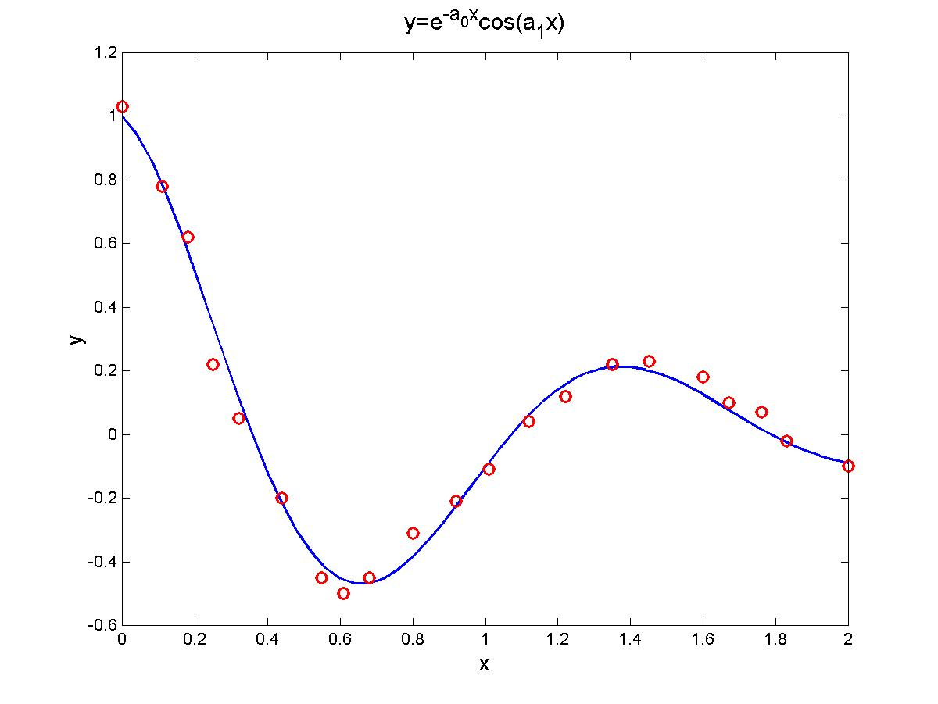
a₀ = 1.1030, a₁ = 4.3972

Slide 30
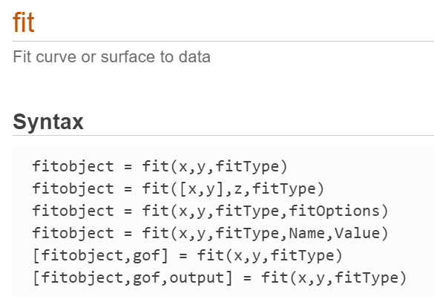
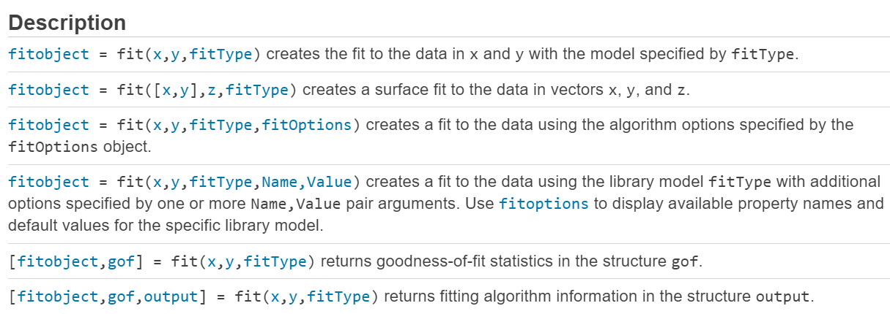
Curve Fitting in Matlab

